Slide 1
Comprehensive VHDL Hamdi Abdelbagi Phone: (937) 830-7761 Email: abdelbagih1@udayton.edu

Slide 2
Design Entities
Aim
To understand the “software”-like VHDL constructs required by procedural testbench
Topics covered
Subprogram – Procedures
Subprogram – Functions
Parameters and parameter association
Packages
Subprograms in packages
Overloading and ambiguity

Slide 3
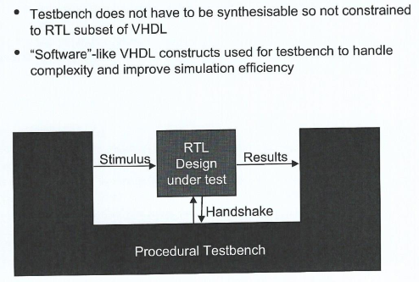
Procedural Testbench Structure

Slide 4
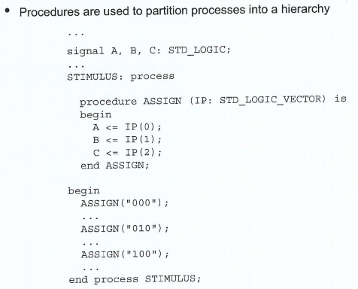
Procedures

Slide 5
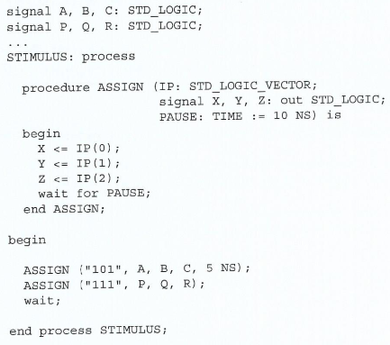
Procedure

Slide 6
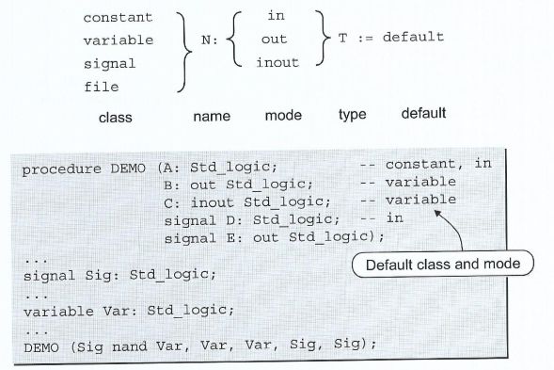
Parameters

Slide 7
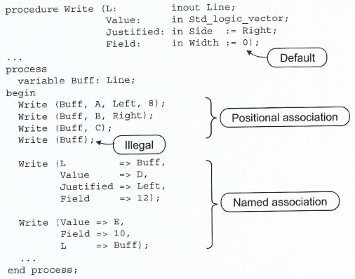
Parameter Association

Slide 8
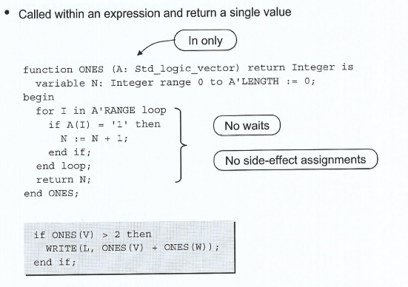
Functions

Slide 9
Function Example
function divide (a : UNSIGNED; b : UNSIGNED) return UNSIGNED is variable a1 : unsigned(a'length-1 downto 0):=a; variable b1 : unsigned(b'length-1 downto 0):=b; variable p1 : unsigned(b'length downto 0):= (others => '0'); variable i : integer:=0; begin for i in 0 to b'length-1 loop p1(b'length-1 downto 1) := p1(b'length-2 downto 0); p1(0) := a1(a'length-1); a1(a'length-1 downto 1) := a1(a'length-2 downto 0); p1 := p1-b1; if(p1(b'length-1) ='1') then a1(0) :='0'; p1 := p1+b1; else a1(0) :='1'; end if; end loop; return a1; end divide;

Slide 10
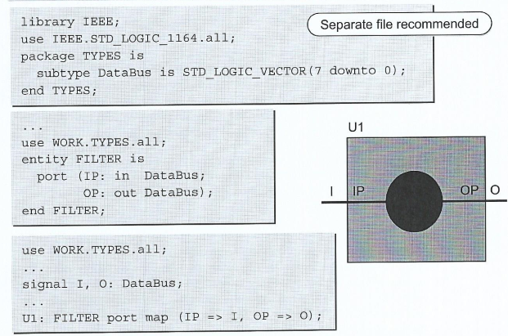
Packages

Slide 11
Package Example
library ieee;
use ieee.std_logic_1164.all;
use ieee.std_logic_unsigned.all;
package tune_time_package is
type DATA_ARRAY is array ( 1 to 32) of std_logic_vector( 7 downto 0);
end tune_time_package;
library ieee;
use ieee.std_logic_1164.all;
use ieee.std_logic_unsigned.all;
use IEEE.Numeric_Std.all;
use work.tune_time_package.all;
entity tune_time_parallel is
generic
(
TUNE_DATA : DATA_ARRAY -- arry to hold the tune word data
);
port
(
i_rst : in std_logic;
i_clk : in std_logic;
o_signal : out DATA_ARRAY;
o_data : out std_logic_vector ( 7 downto 0 )
);
signal data_z : DATA_ARRAY;

Slide 12
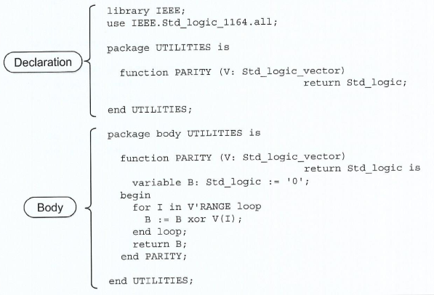
Subprogram in Packages

Slide 13
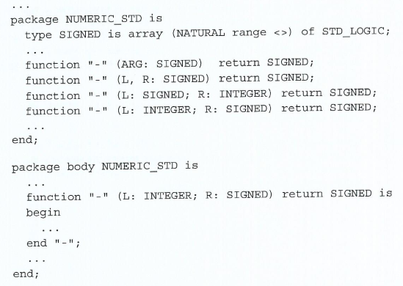
Arithmetic Package

Slide 14
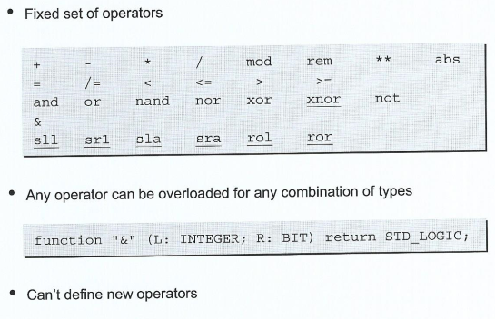
Operator Overloading

Slide 15
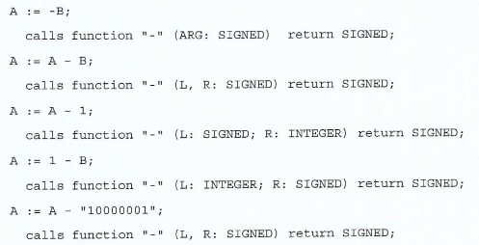

Using Overloaded Operators

Slide 16
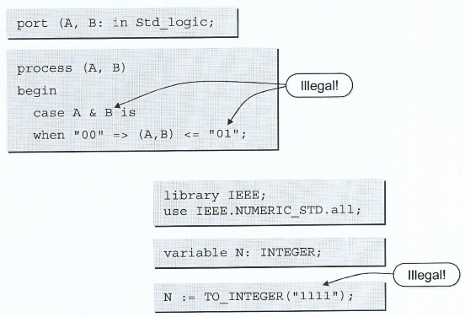
Ambiguous Types

Slide 17
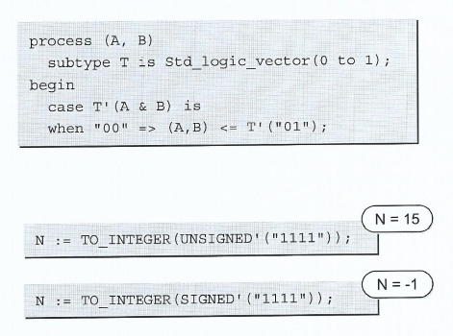
Qualified Expressions

Slide 18
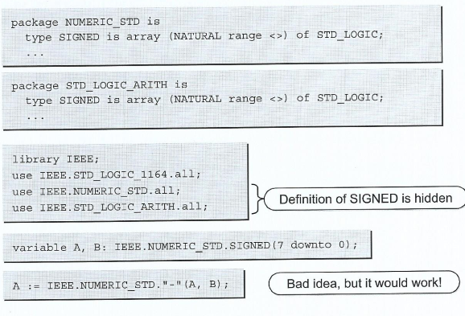
Ambiguity is Use Clauses

Slide 19
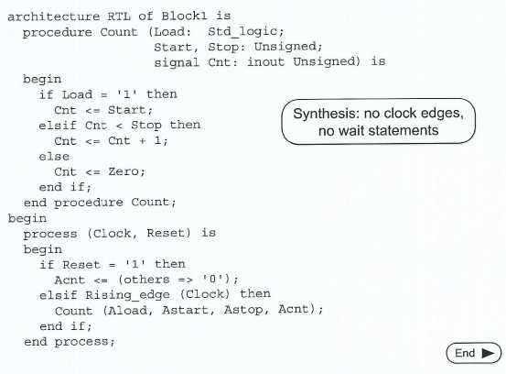
RTL Procedure

